Slide 1
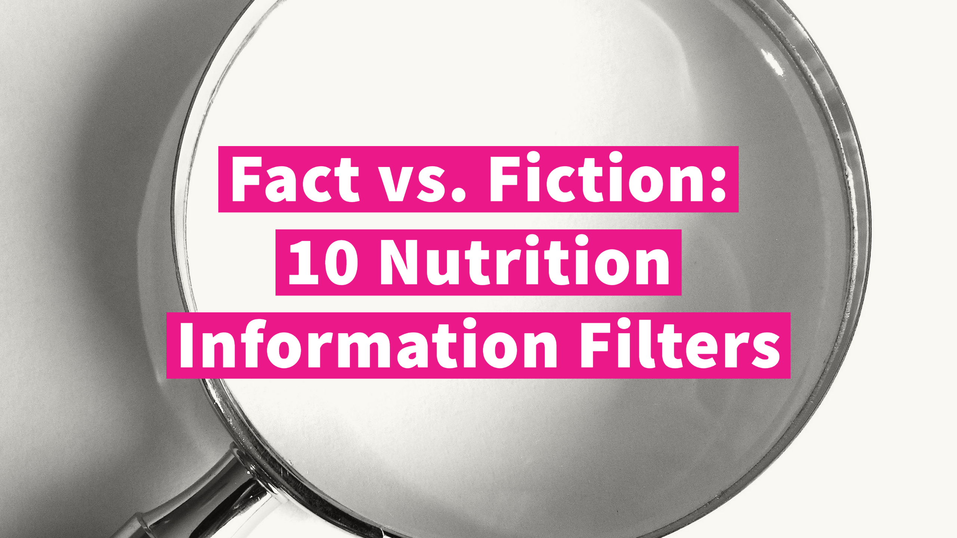
Notes:
Do you ever struggle with filtering fact from fiction on the internet? Do your clients, patients, or audiences struggle with this as well?
Introduce yourself.
This slideshow shares 10 nutrition information filters for separating fact from fiction.

Slide 2
Learn more about the book: bit.ly/communicating-nutrition
Notes:
The information in this presentation is based on materials in the book Communicating Nutrition: The Authoritative Guide by the Academy of Nutrition and Dietetics. For more information about the book, visit bit.ly/communicating-nutrition.

Slide 3
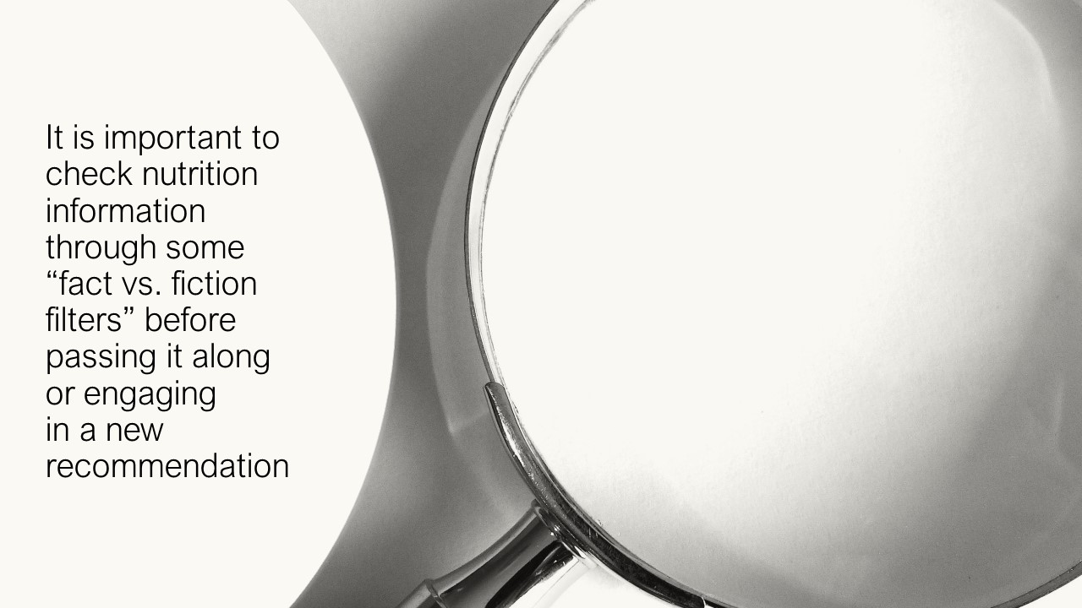
Notes:
Before sharing a social media post, giving a talk, writing an article, or engaging in a new recommendation, it is important to check nutrition information through some nutrition fact vs. fiction filters.
Promoting or following inaccurate nutrition information can:
Be a waste of time and/or money
Be unsafe if the information proves harmful
Delay needed treatment if trying to cure a health problem with misinformation
Damage your professional credibility if you’re a professional nutrition communicator
Let’s look at the 10 “fact vs. fiction filters” for nutrition information sources:

Slide 4
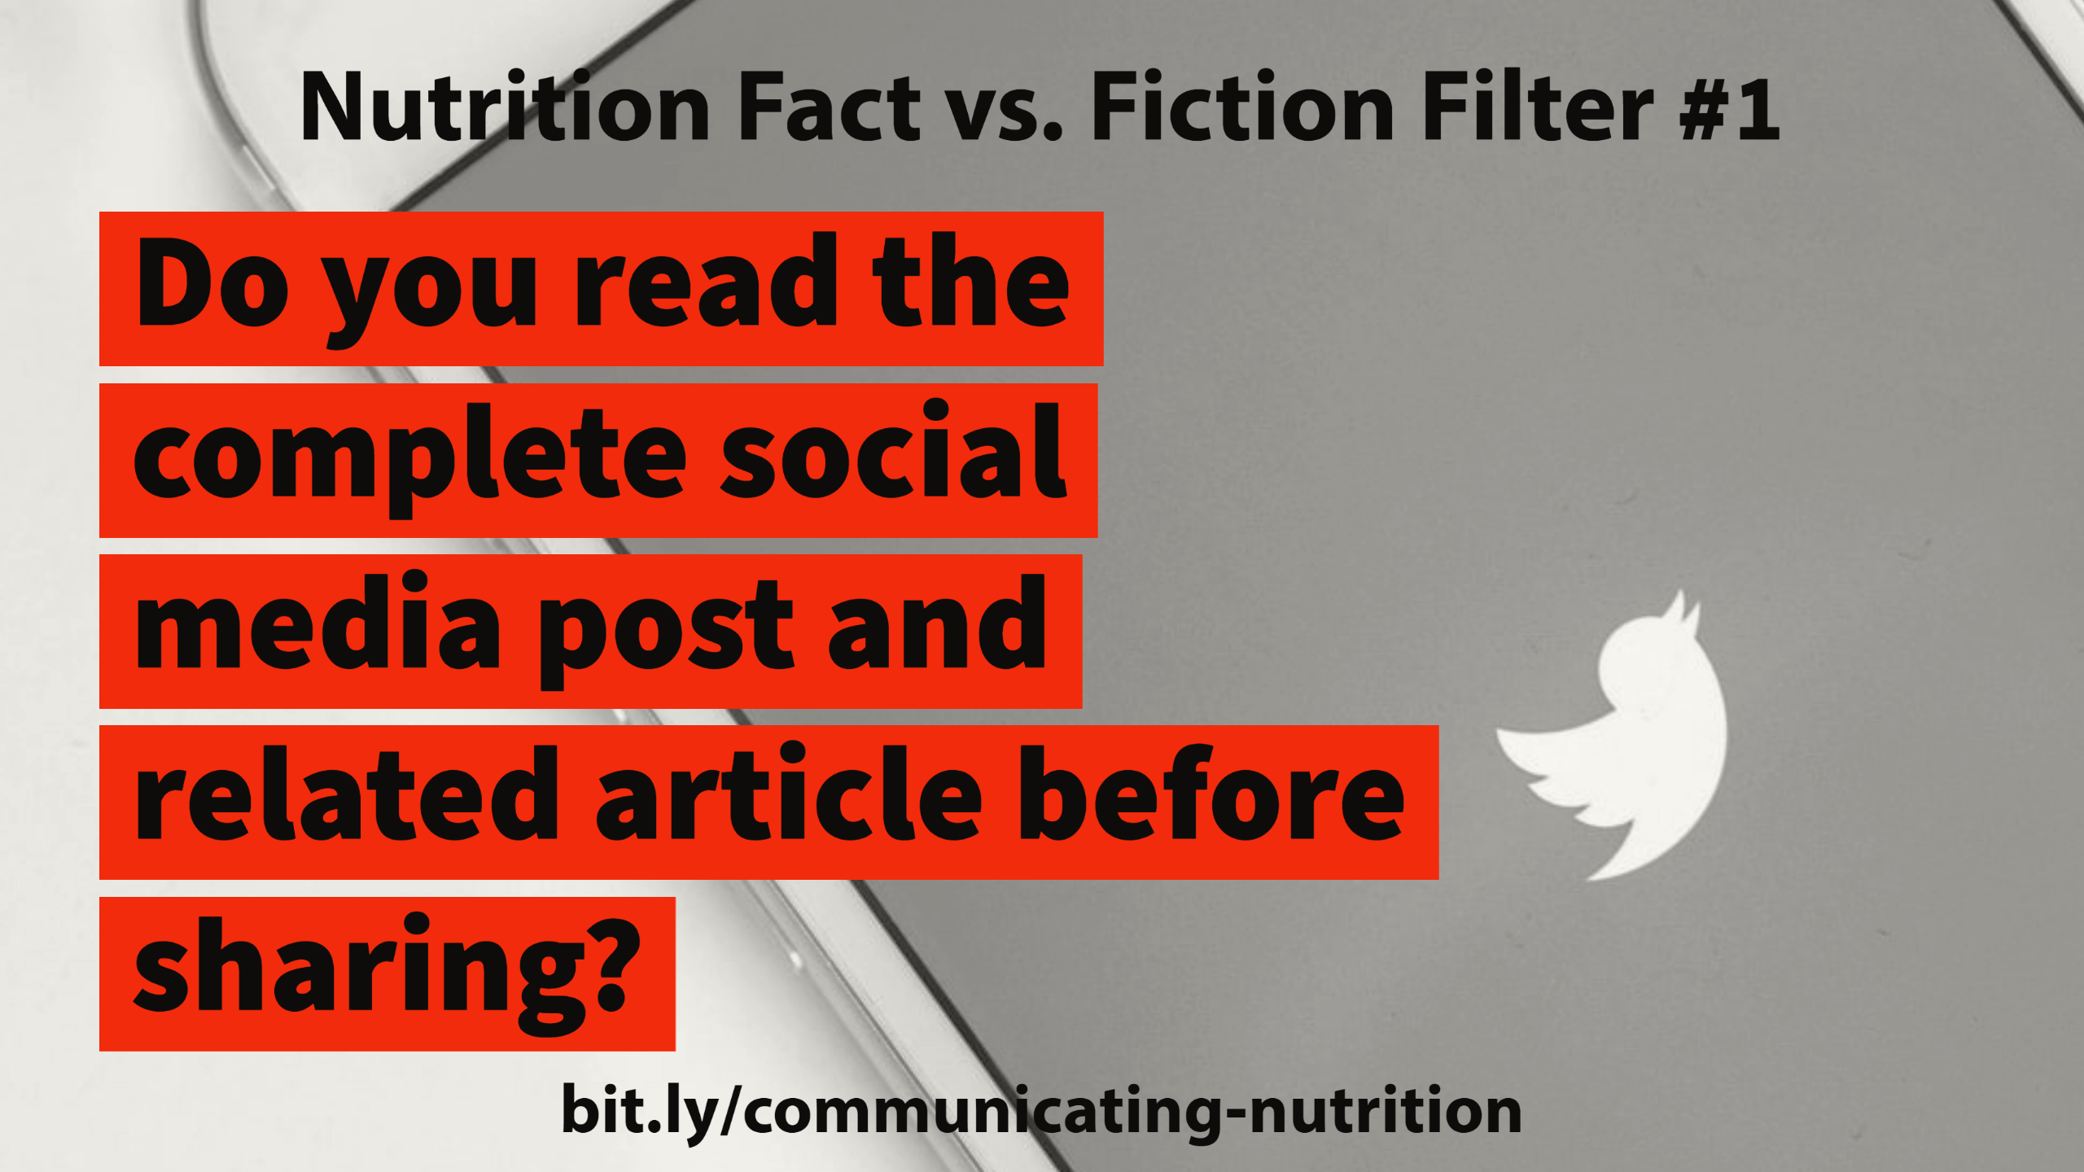
Notes:
In a study by Columbia University and the French National Institute, people share 59% of Twitter links without reading them. Massachusetts Institute of Technology researchers found that, in general, false news was 70% more likely to be retweeted than the truth.

Slide 5
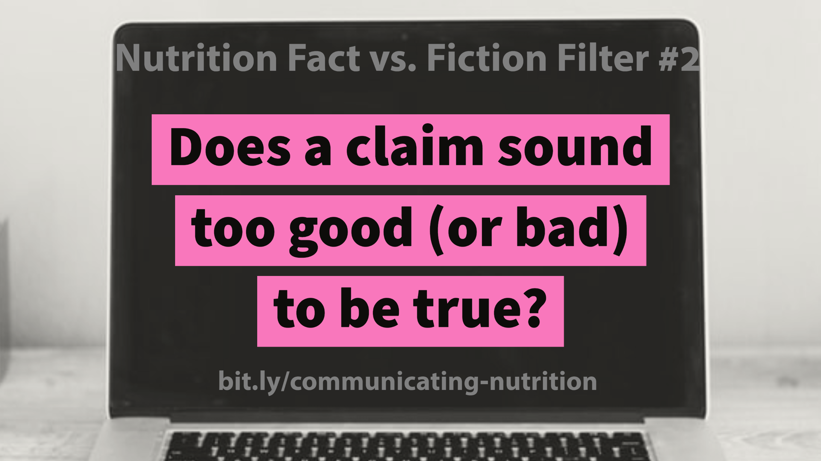
Notes:
A claim that sounds too good (or bad!) to be true, probably is. Beware of headlines that appear to be clickbait or share bait. They’re designed to make people want to click on them ‒ or even without clicking, share them. Common claims involve rapid weight loss or dire consequences if you eat a certain food. Here’s an adaptation of a recent one with names and products changed: “Jane started eating two servings of this fruit every day for a week and the results are amazing!”

Slide 6
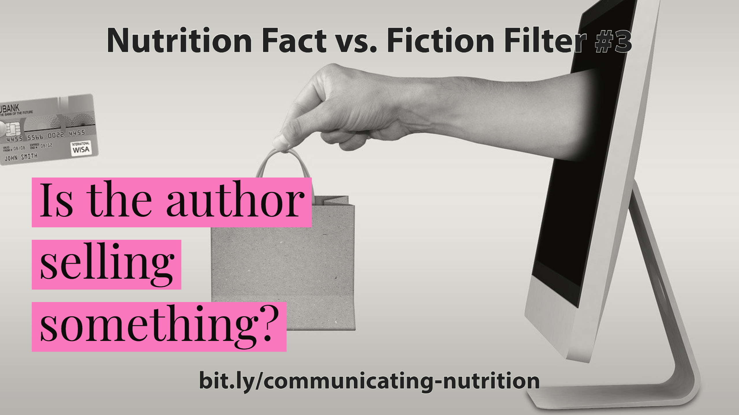
Notes:
Put on your detective hat. Check the type and source of testing to assure the information or product is safe. Also, what are the author’s qualifications in this area. More on these later.

Slide 7
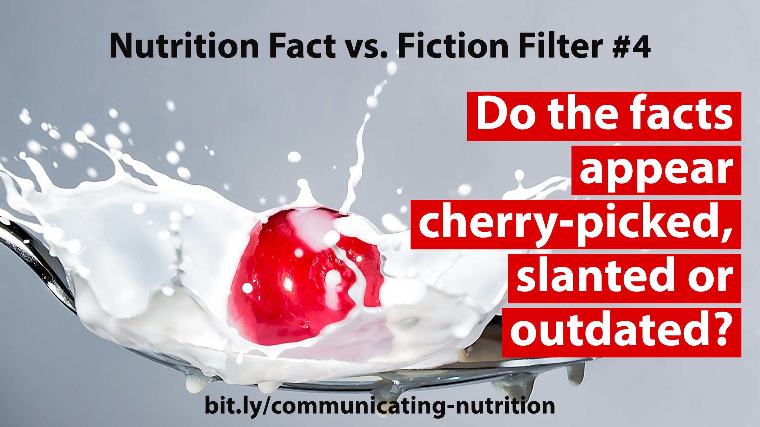
Notes:
Are only supportive facts given? How recent is the information? For example, there might be several studies on a given topic, but a person only mentions the few studies that supports his or her viewpoint. Look for dates on cited studies … science is constantly evolving. Recommendations from older studies may no longer give the best advice.

Slide 8
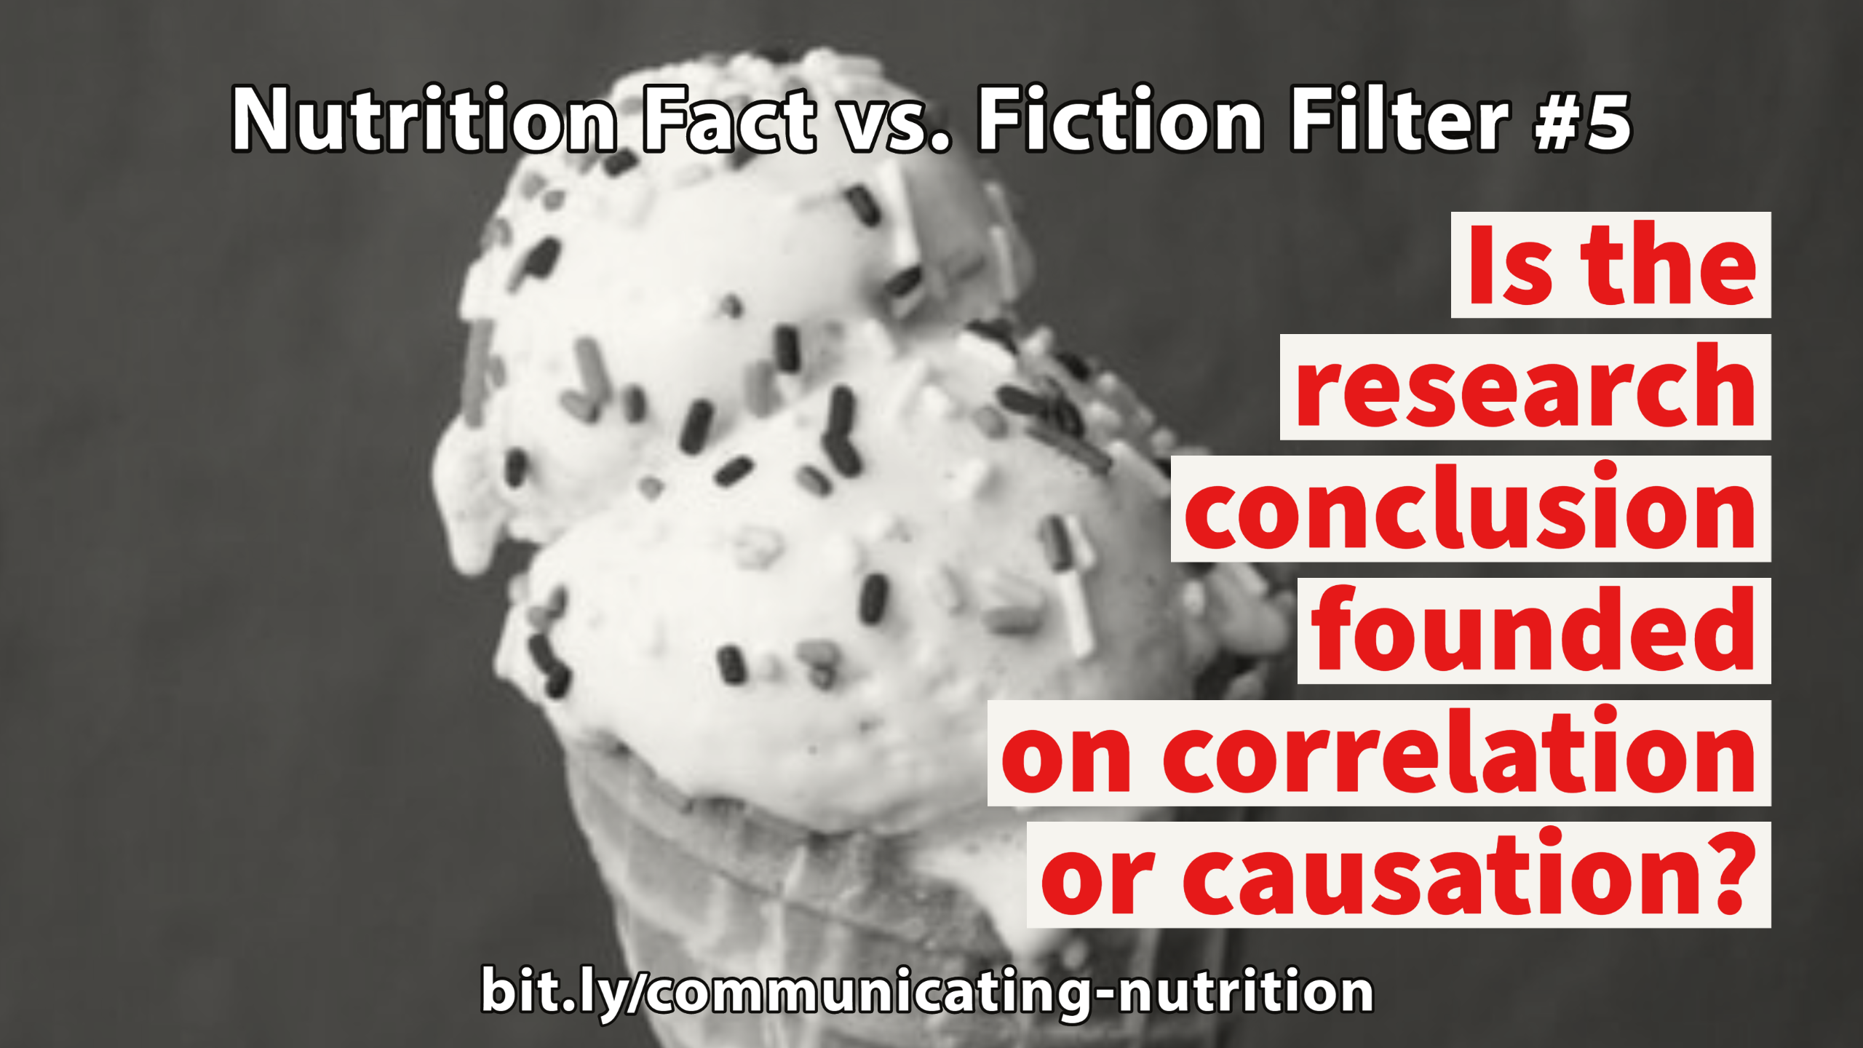
Notes:
“Correlation” is when one variable increases or decreases proportionally to changes in the other. “Causation” means that one event causes another event to occur. For example, several experts in the 1950s believed ice cream caused polio. Both the number of polio cases and ice cream consumption peaked during the summer. While correlation may show possible causes, it can’t determine whether something is a cause. More study found the polio virus was more virulent in the warm summer months and caused more disease. And, everyone could happily go back to eating ice cream!

Slide 9
Notes:
People may say they feel better after trying a certain product, diet or treatment because they think it will make them feel better. It’s called the “placebo effect.” For example: Studies sometimes use placebos, such as an inactive treatment like a sugar pill, to evaluate the effect of a drug.

Slide 10
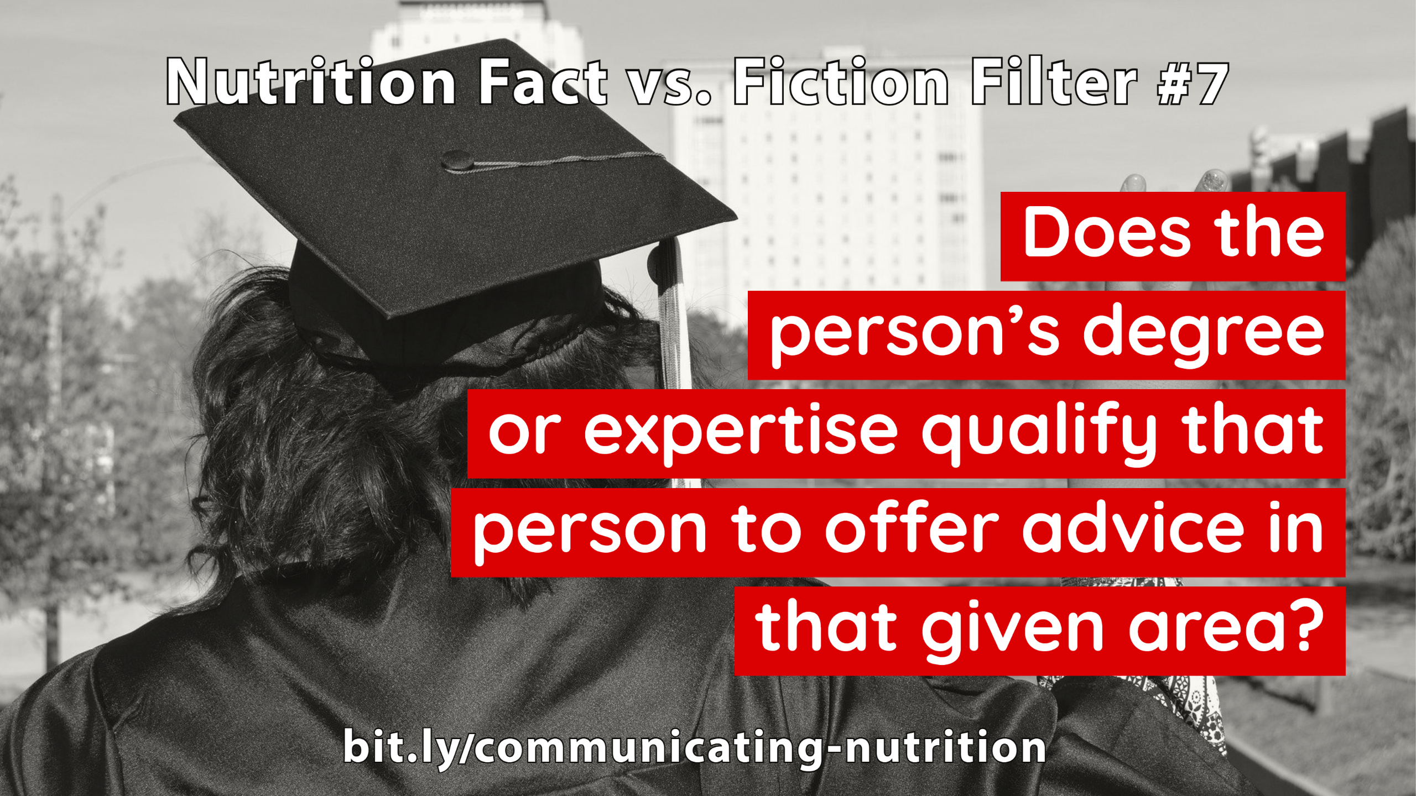
Notes:
A common example is a physician or other health professional with no or limited nutrition training who gives nutrition advice without any current body of science to support it. Check out their degree and where they obtained it. Some degrees can be obtained easily via the Internet. There are examples of animals whose owners obtained PhDs for them through diploma mills. One of the most famous animals with a PhD was “Dr. Zoe D. Katze (K-A-T-Z-E),” a housecat!

Slide 11
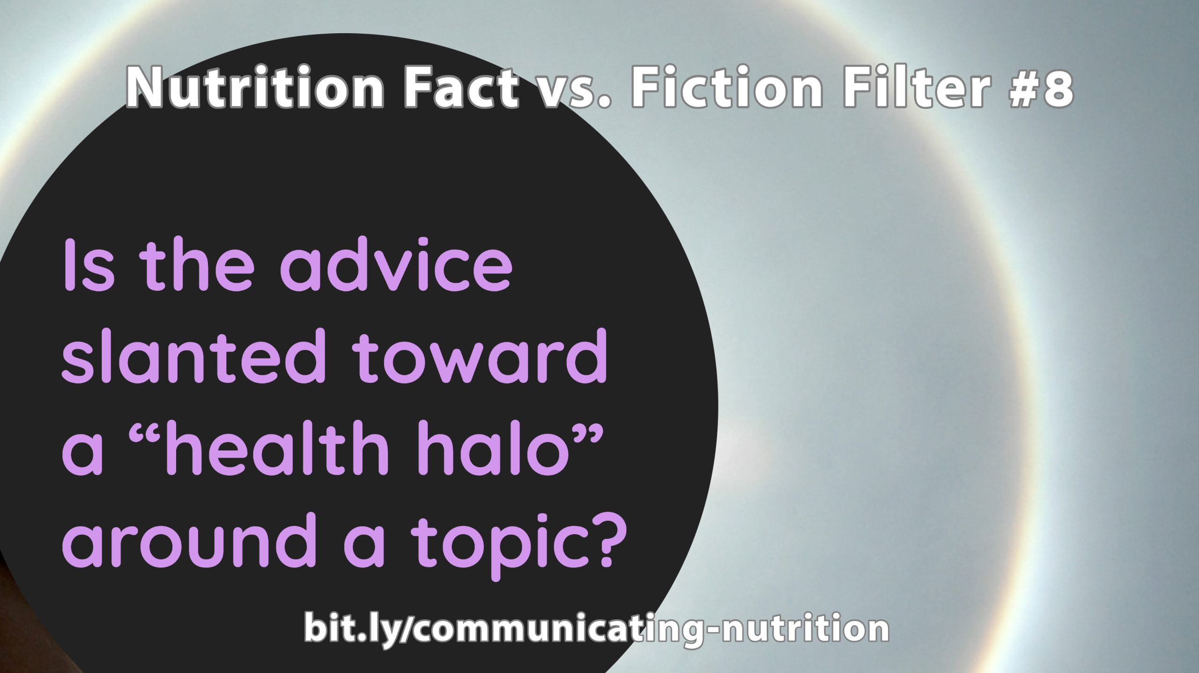
Notes:
The “health halo” effect occurs when the healthfulness of a food is based on a single characteristic. For example, someone may recommend a food because it is high in fiber. However, that food may be less angelic on closer look. A high-fiber muffin might be loaded with sugar and calories. Or it might be made mostly with a refined flour with some bran thrown in.

Slide 12
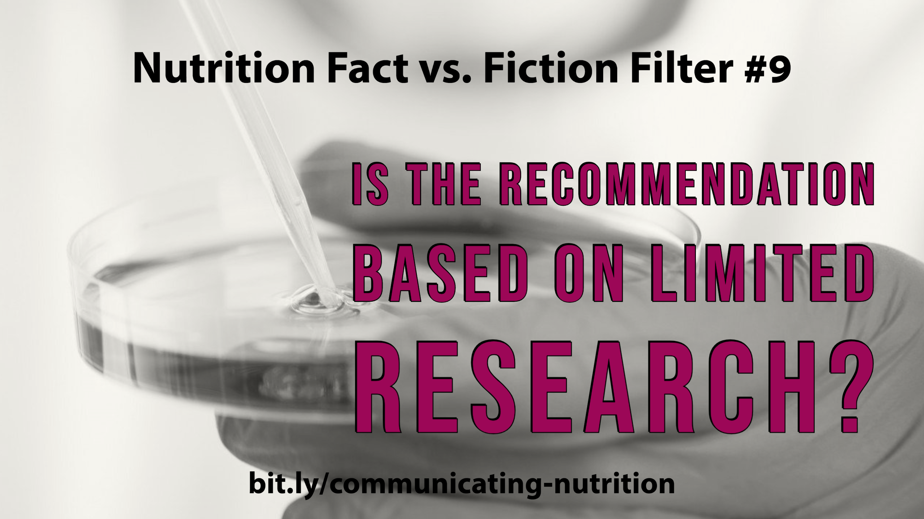
Notes:
Before embracing a radical or unbalanced dietary recommendation, check for research to support it. Is the recommendation based on just a few small samples of people? Has it proven successful and healthy over a period of time? One example is taking huge doses of a vitamin or mineral because an initial study suggested it might help prevent a specific condition. After further research, however, it might be found too much could cause an adverse effect!

Slide 13
Notes:
This filter goes along with the “correlation or causation” filter. For example, does eating a certain food cause a dietary problem or do people eat less of other high-nutrient foods if they fill up on that food? Did the experiment look at the total diet? Were mostly less healthy people the ones eating that food?

Slide 15
bit.ly/communicating-nutrition
Notes:
Leave this slide up at end of talk

